Slide 1


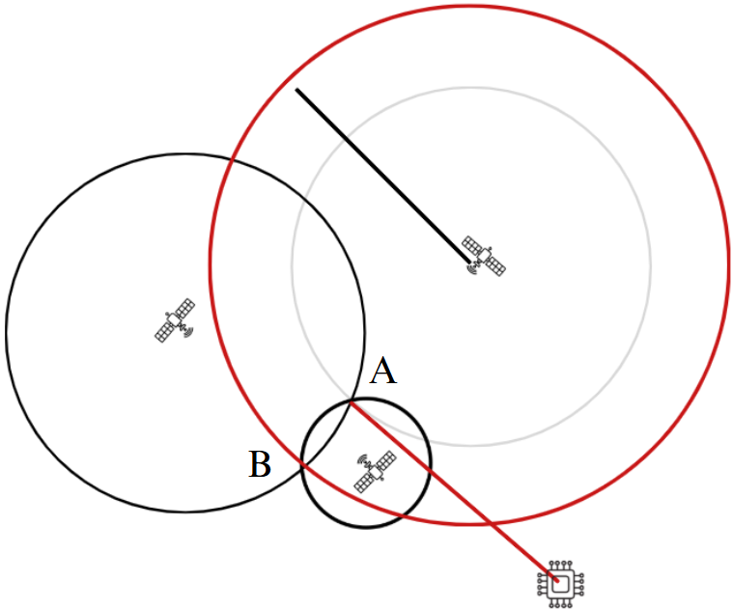
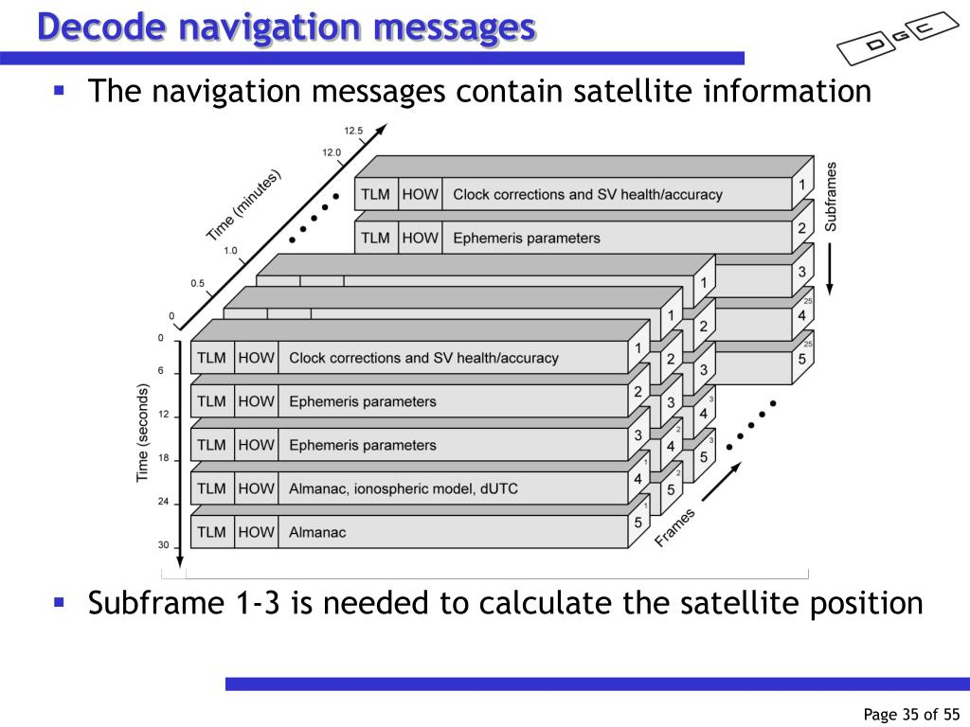
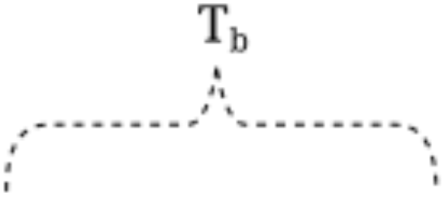
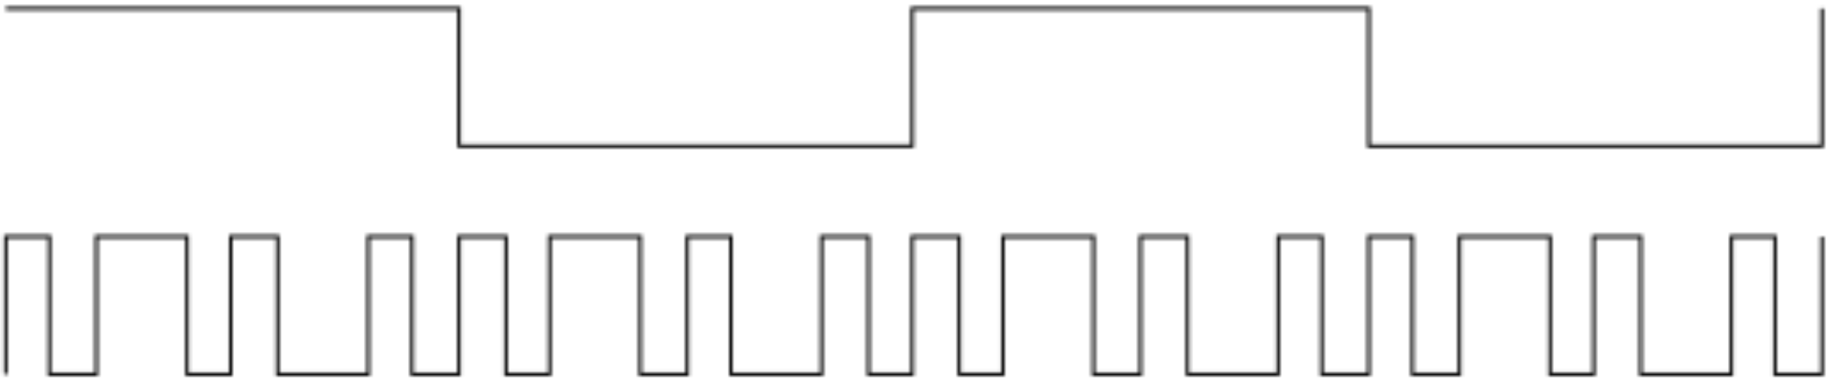
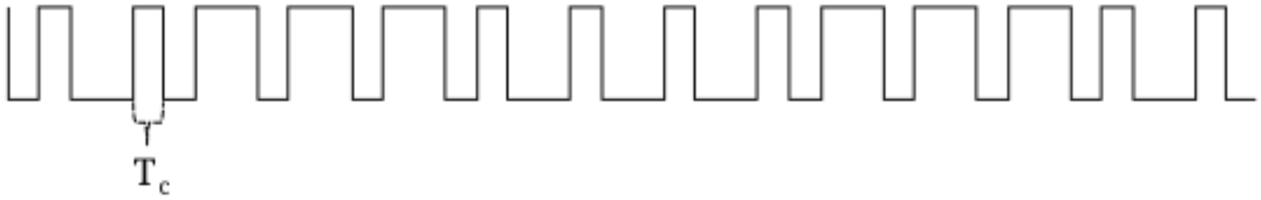
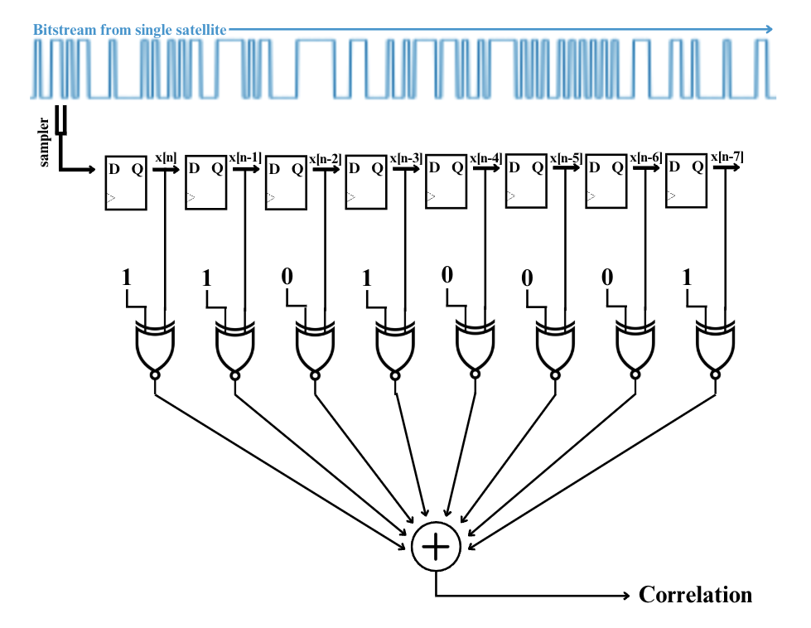
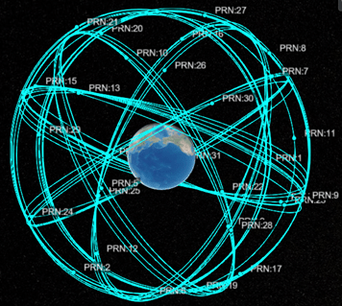
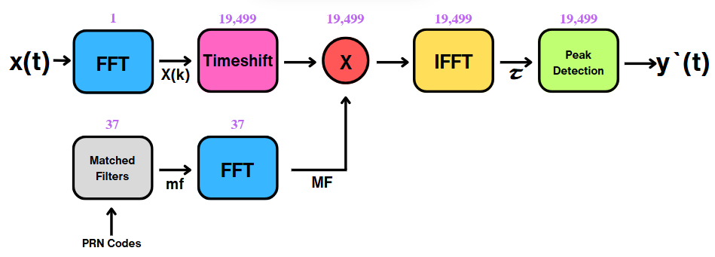
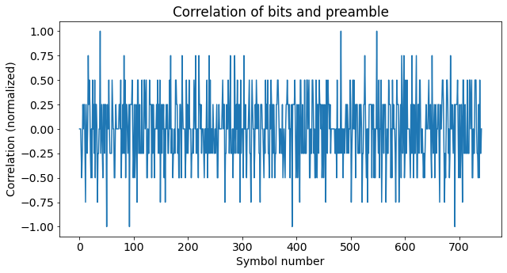
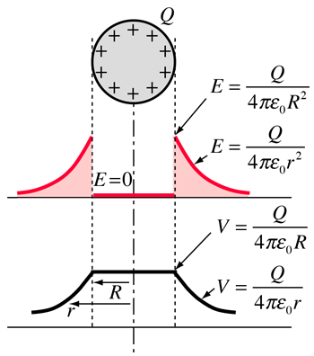
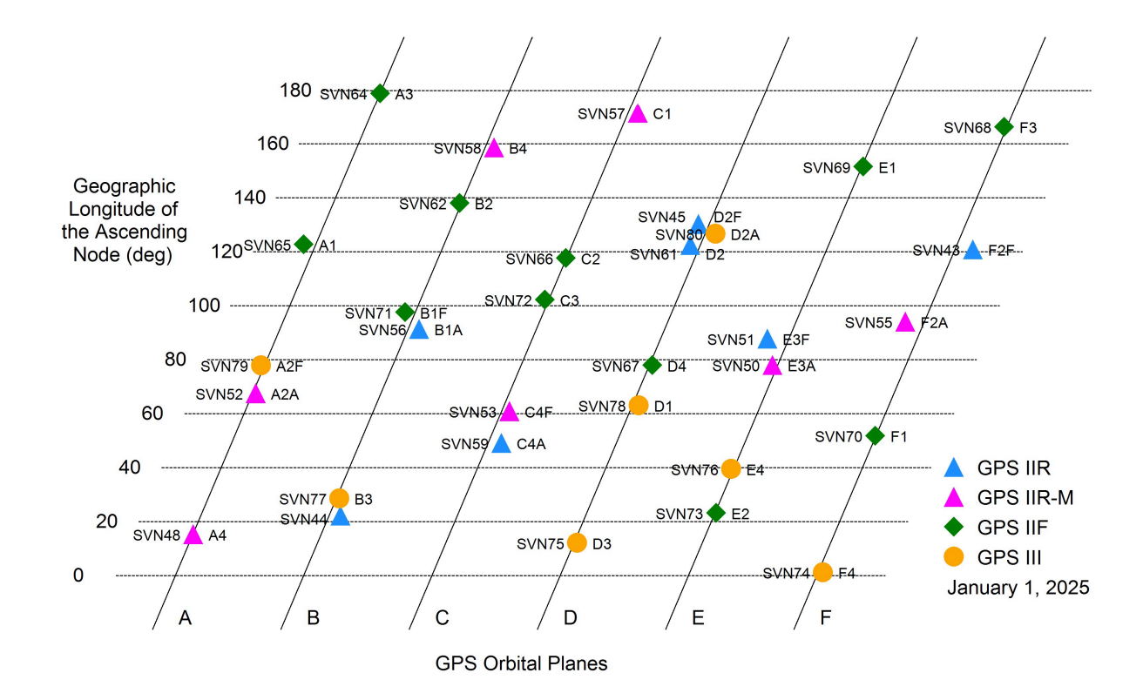
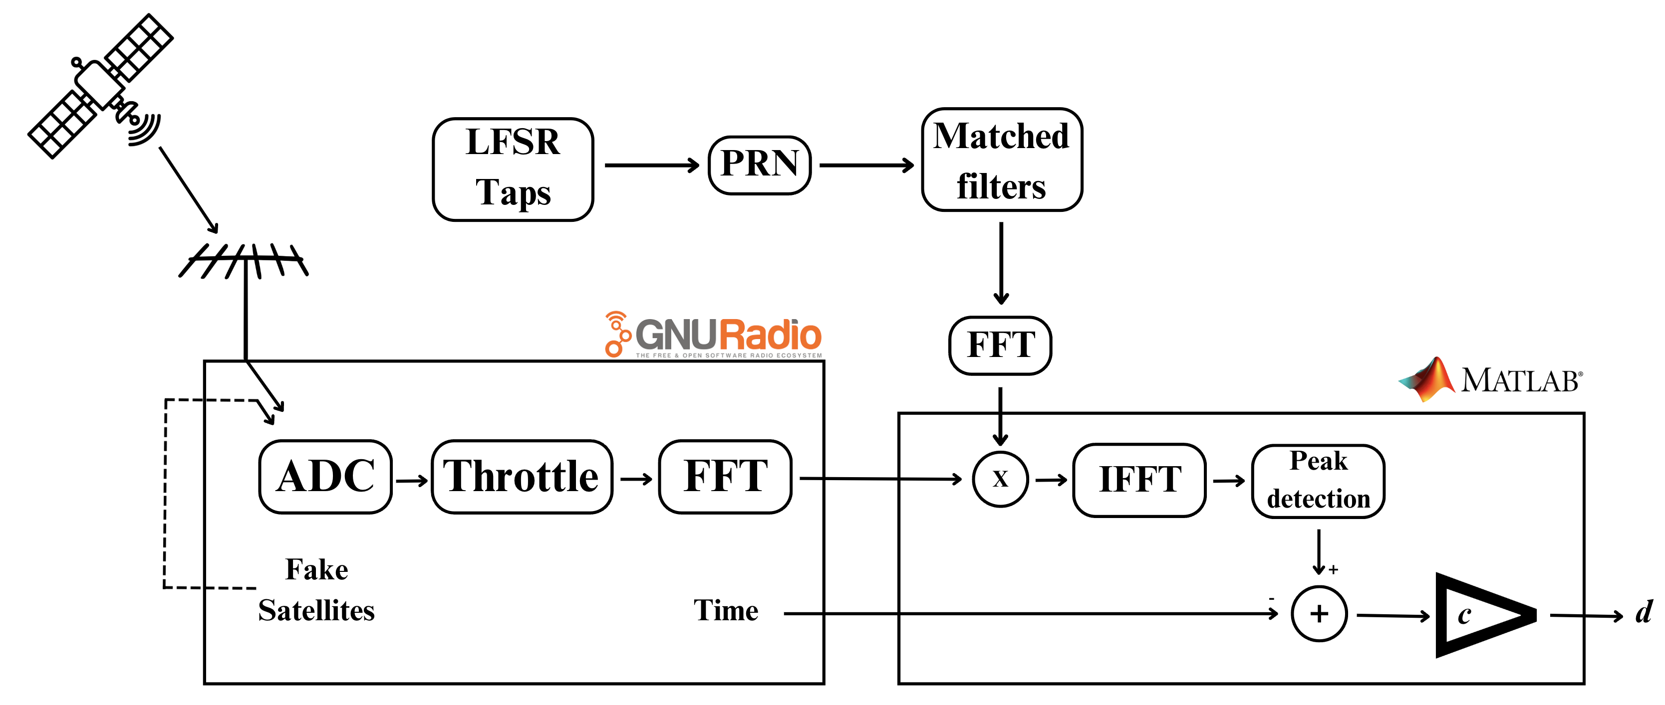


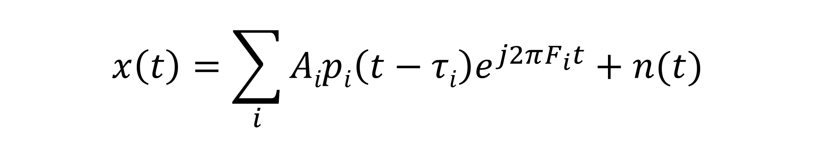
Practical GPS Spoofing
XOR signal
Background
System
Output
Motivation
Improve existing GPS spoofing algorithms
Objectives
Make a GPS system spoofproof
Detect and locate spoofers
Make an undetectable spoofer
Basic Spoofing
L1 Frames
Data signal
PRN
Preamble Detection
XOR signal
Spoofer Requirements
Understand language satellites speak
Location and velocity of satellite
Complex spoof algorithm
Received Signal
$$x\left(t\right)=\sum_{i}{Aipi\left(t−τi\right)e^{j2πF_{i}t}+n(t)}$$
A = Amplitude p = Satellite Transmission n(t) = Ambient Noise
t = GPS Time F = Doppler Shift Tau (τ) = Time Received
i = Set of All Satellites
24-32 satellites, in 6 orbits, transmitting simultaneously
Each satellite has its own language
Correlation of Bits and Preamble
Determines location of one satellite
GNURadio receiver
Conclusions
Simulated spoofed GPS signals
Increased understanding of GPS protocols
Built a GNURadio GPS receiver
Next steps: Switch to a Unix implementation and use an ADALM-PLUTO receiver
Henry Riker
Electrical Engineering
385-246-7249
mightbehenryriker@gmail.com
Acknowledgements:
Dr. Jacob Gunther, for his exemplary mentorship
Dr. Todd Moon, for volunteering his ADALM-PLUTO device
Dr. Don Cripps, for encouraging students to challenge themselves

